Slide 1
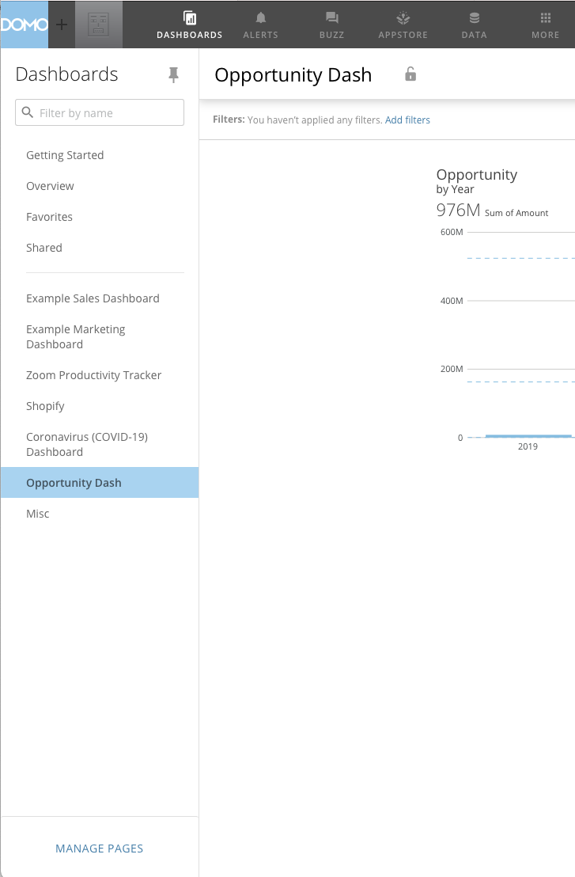
Dashboard Page Search
System Pages
User Pages
Active Page
Pages Menu

Slide 2
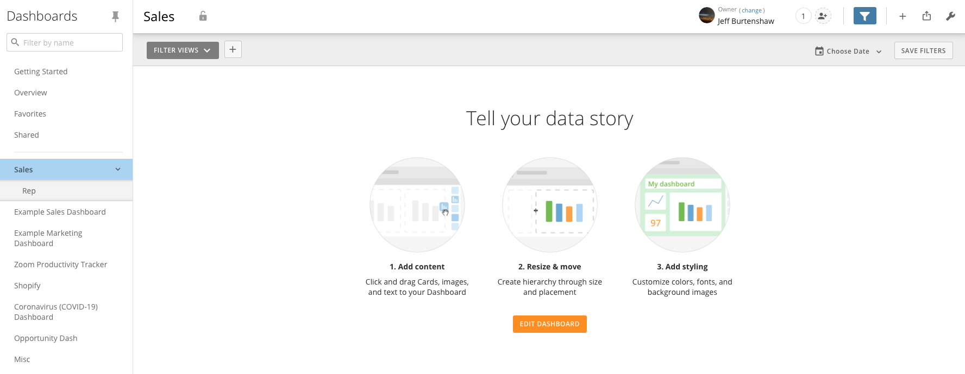
Page
Lock
Dashboard
Owner
Dashboard
Sharing
Filter
Toggle
Add Card Options
Page Sharing Options
Action Options

Slide 3
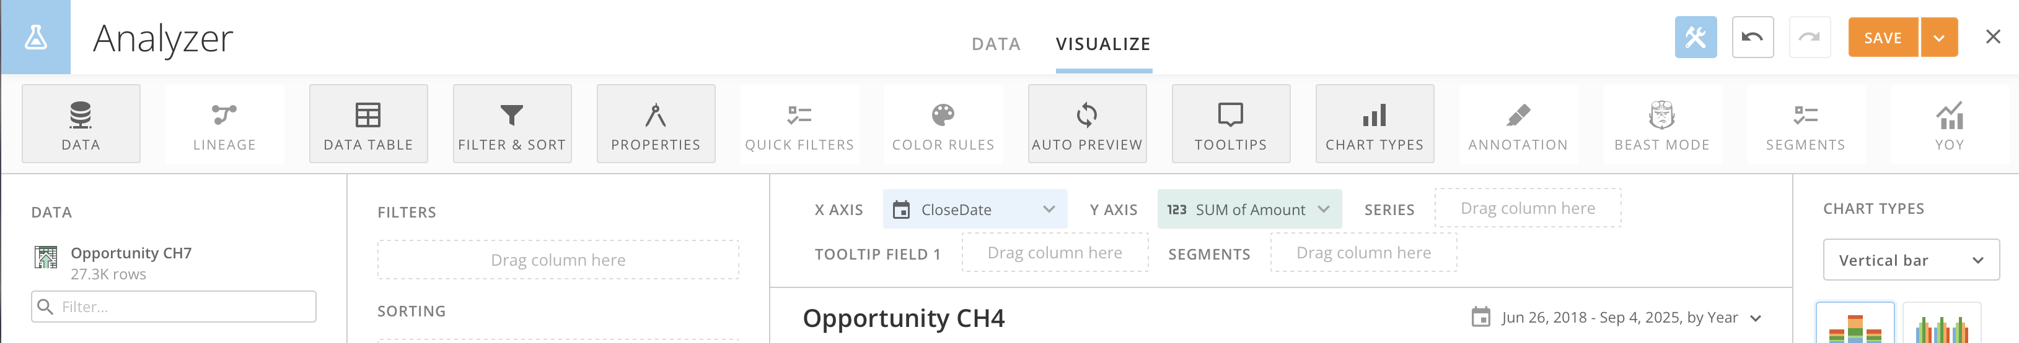
Toolbar

Slide 4
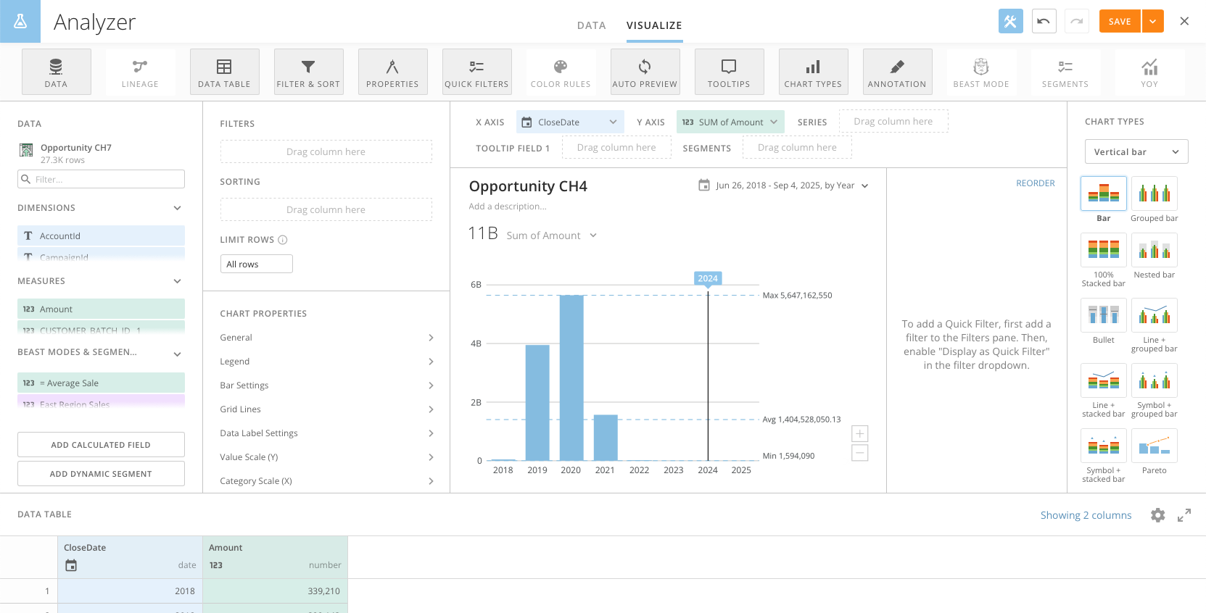
Toolbar Toggle
Icon
Tabs
Undo/Redo
Save
Close
Filters
Chart Fields
Chart Type
Selector
Dataset
Sorting
Title
Quick Filters
Row Limits
Date Range Selector
Summary
Field Finder
Chart Properties
Annotation
Beast Modes
Segments
Data Table
Table Column Chooser
Table Settings
Table Fullscreen Toggle

Slide 5
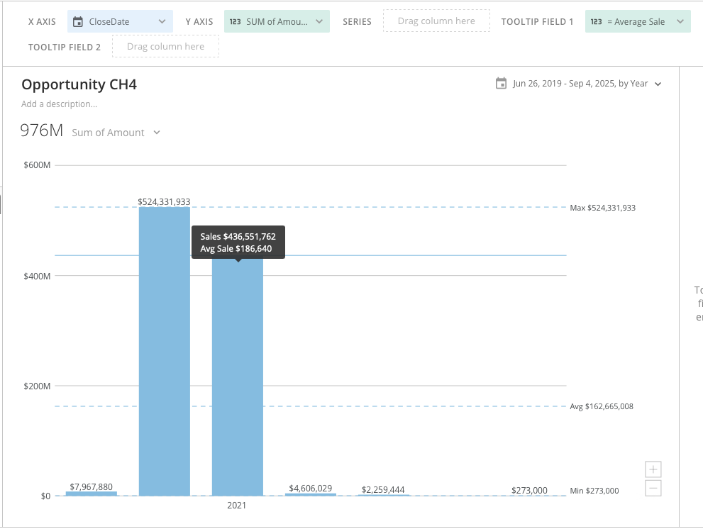

Slide 6
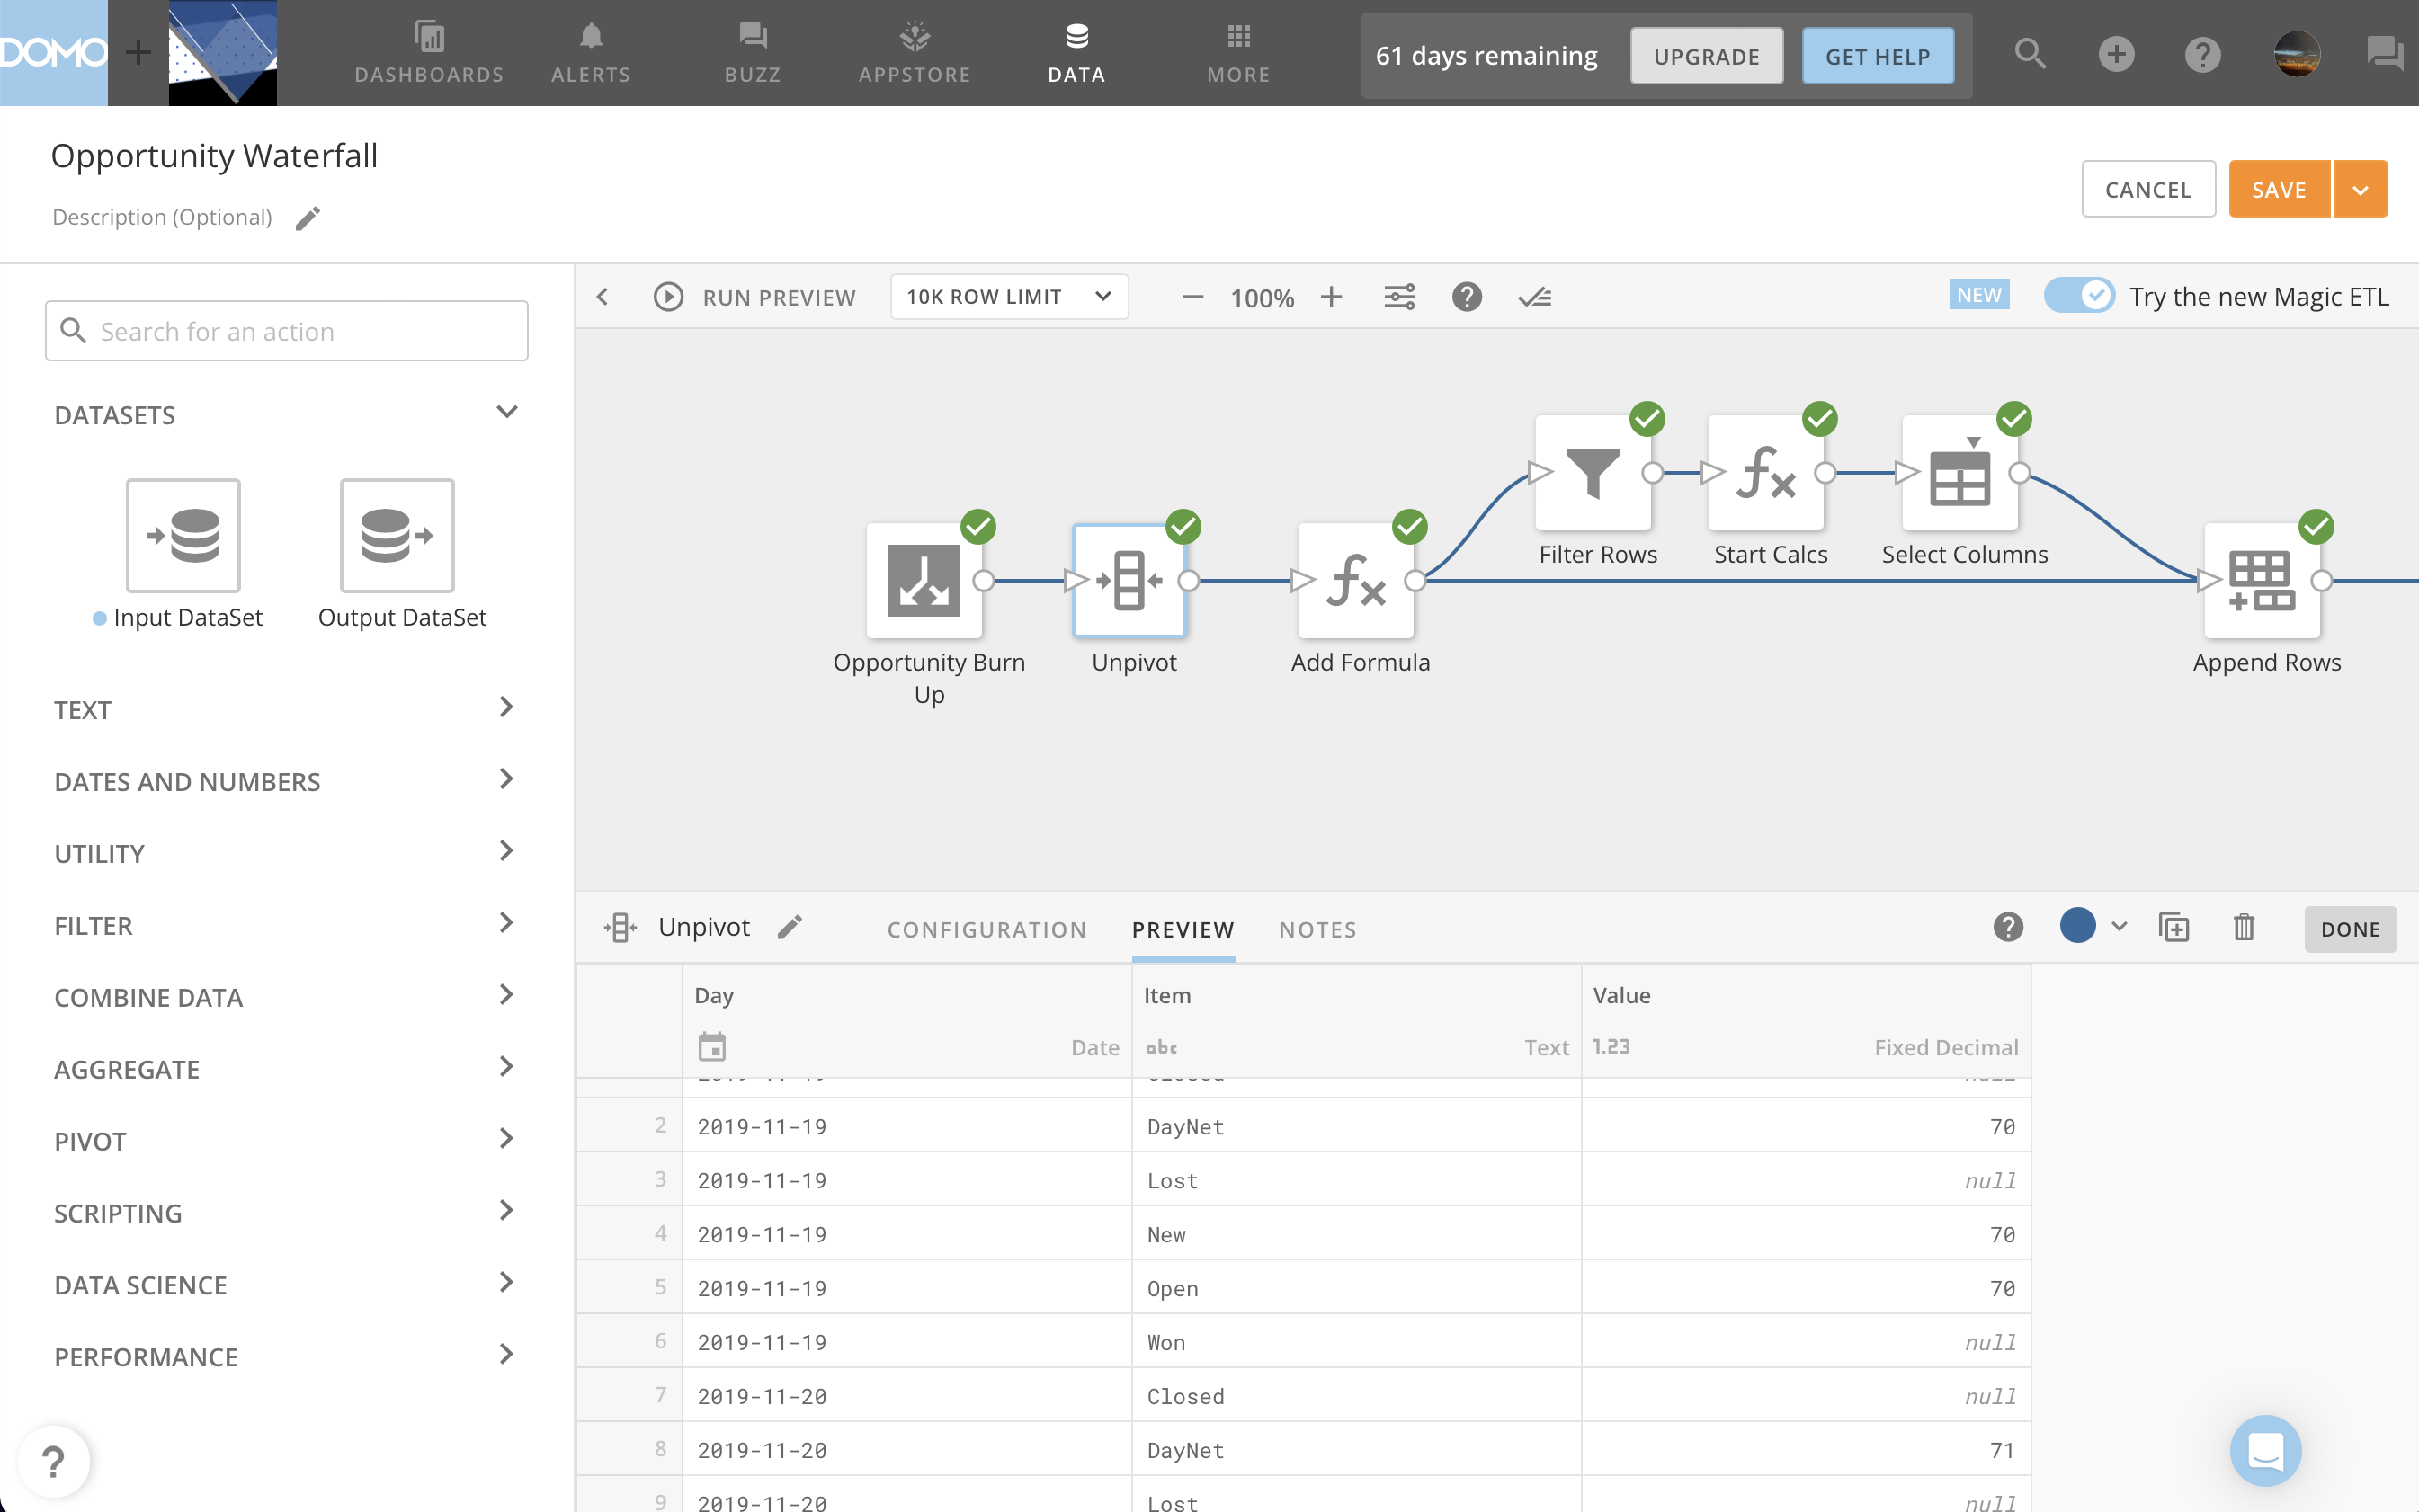

Slide 7
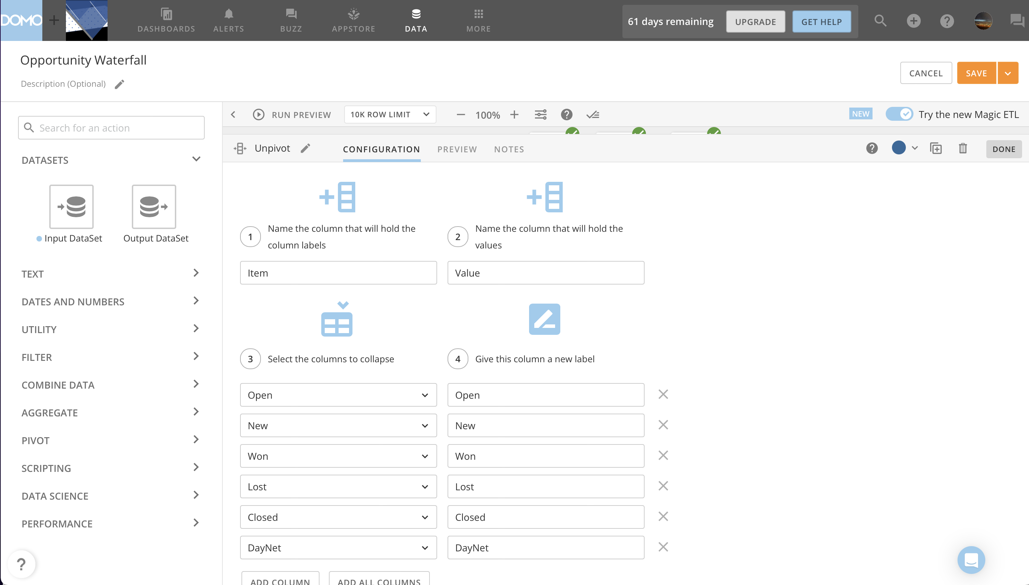

Slide 8
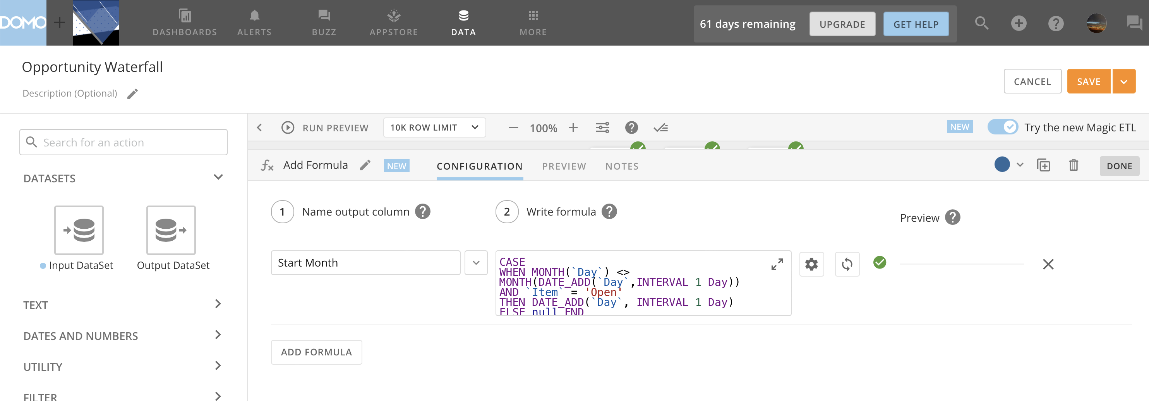

Slide 9
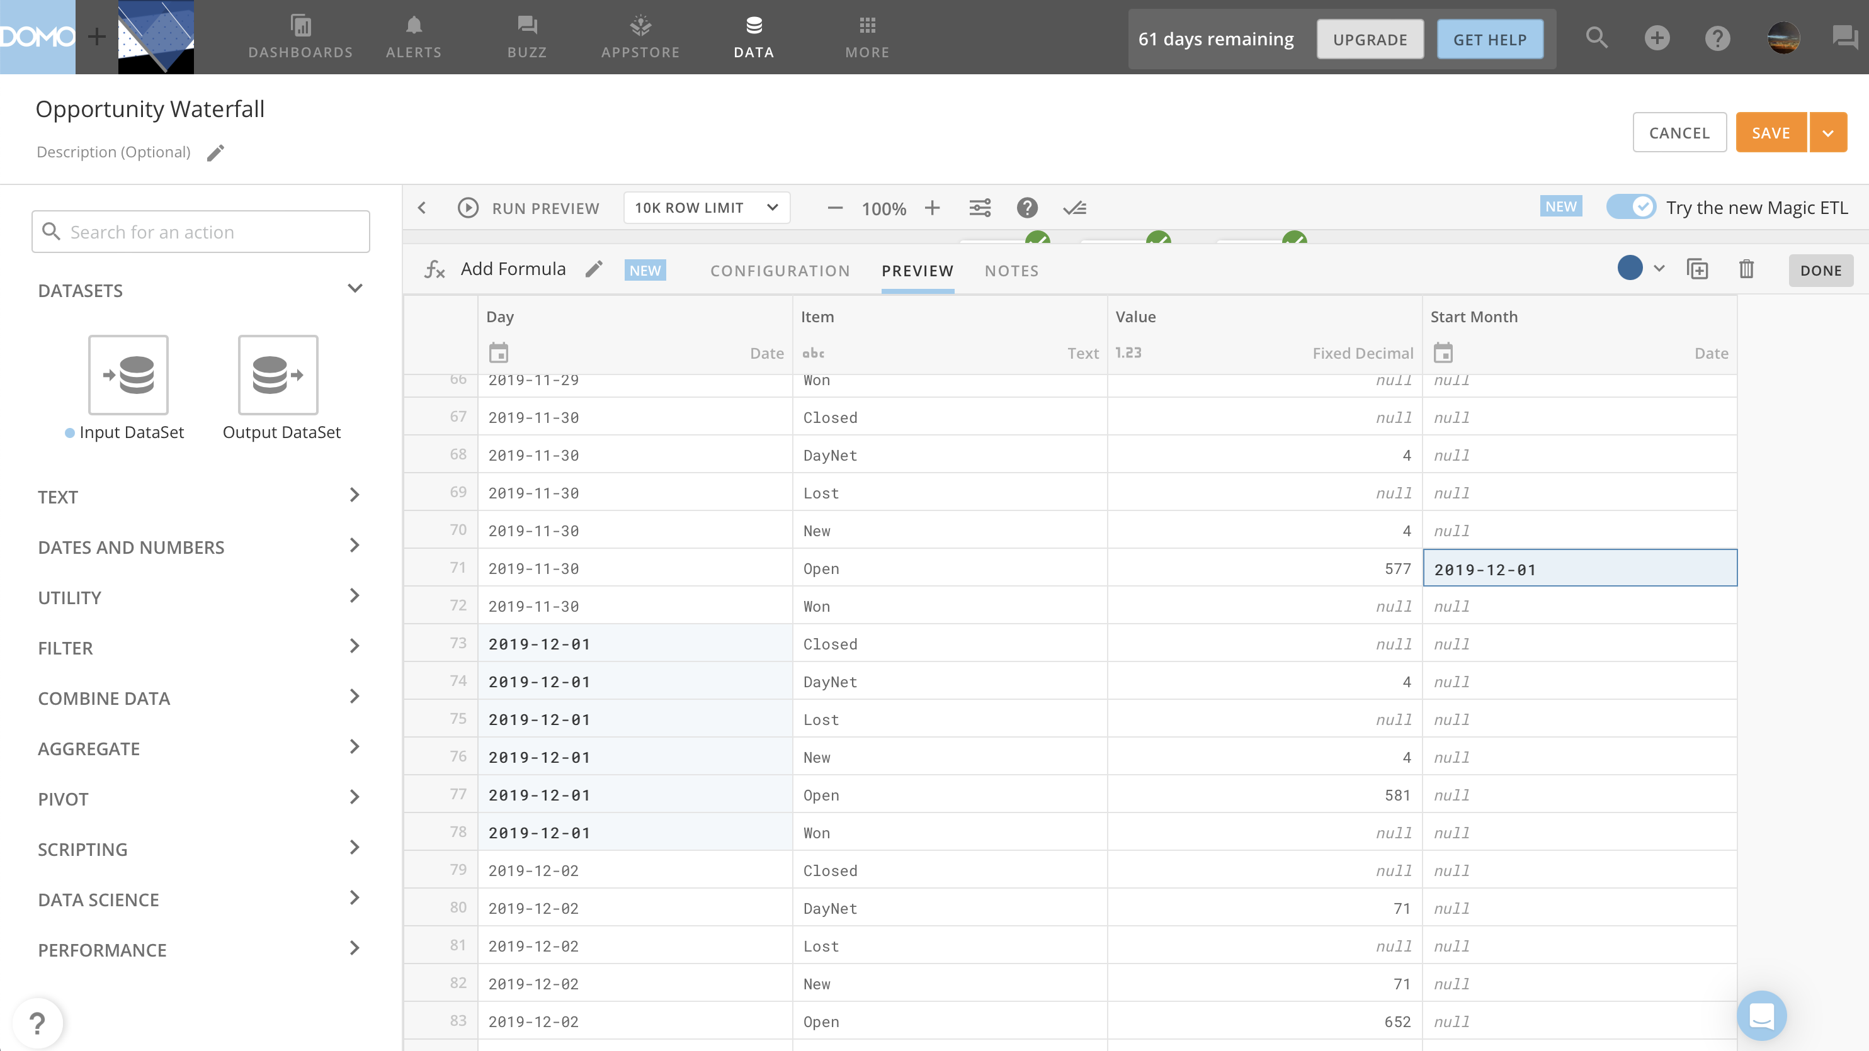

Slide 10
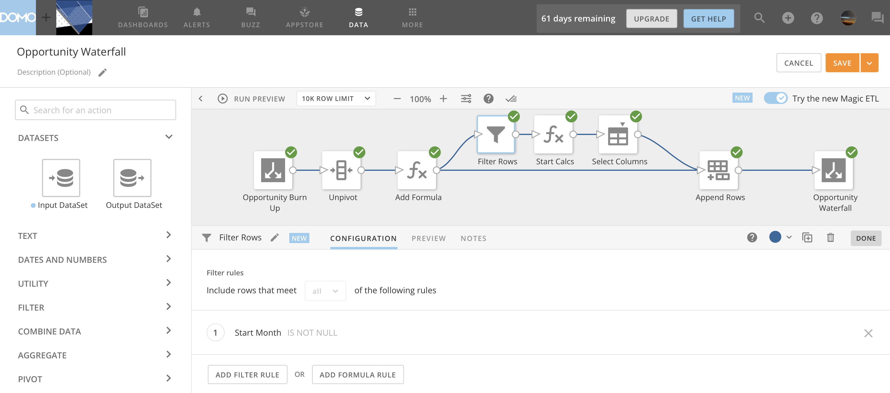

Slide 11
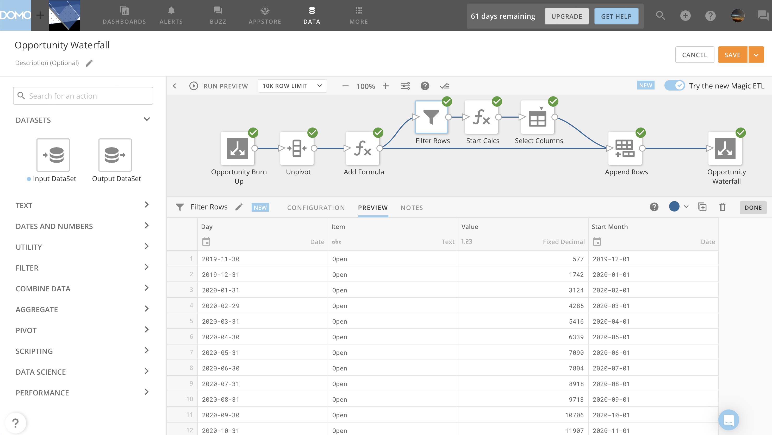

Slide 12
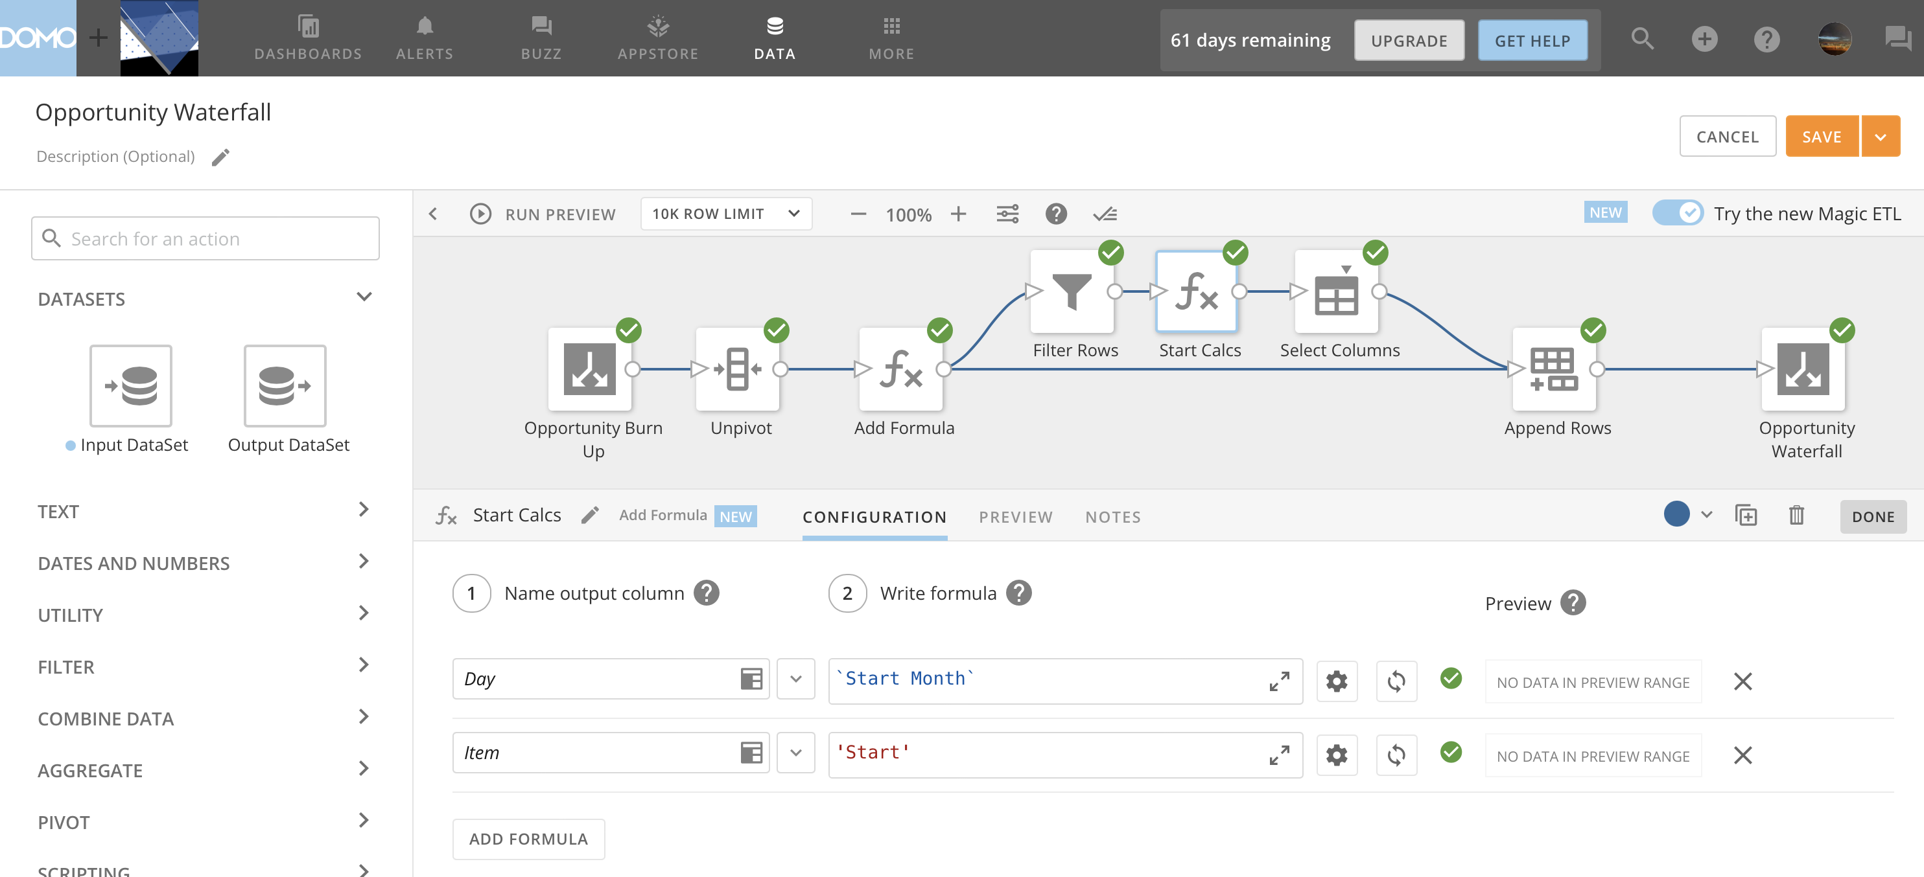

Slide 13
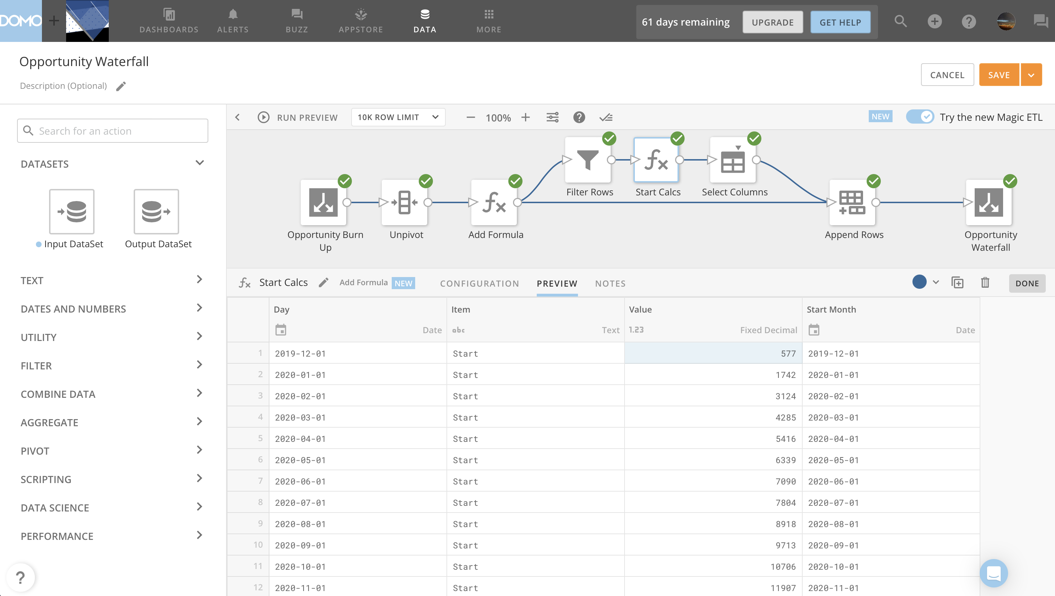

Slide 14
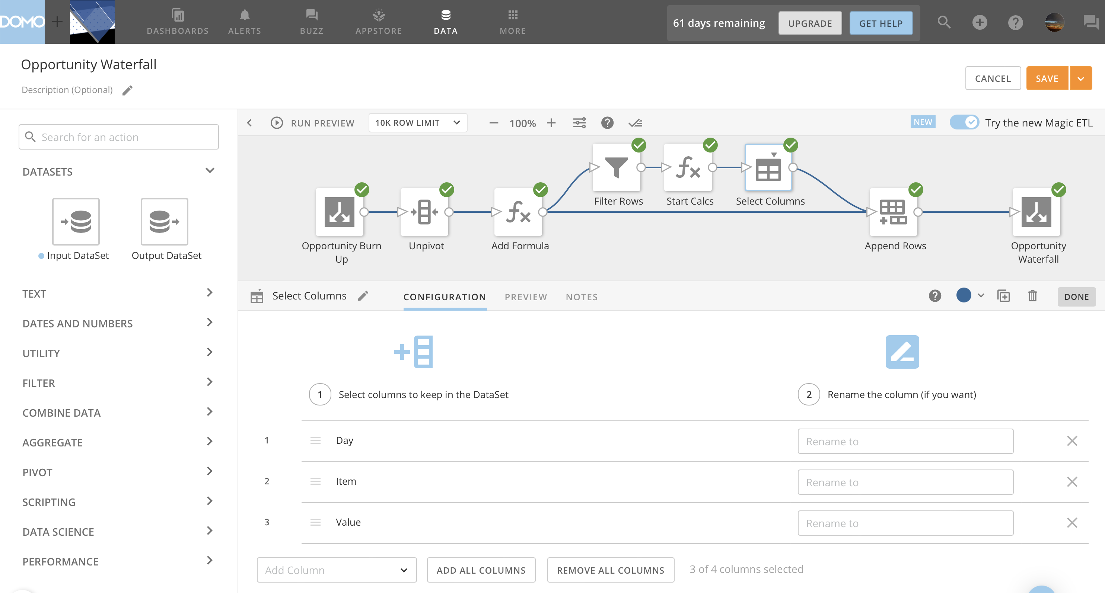

Slide 15
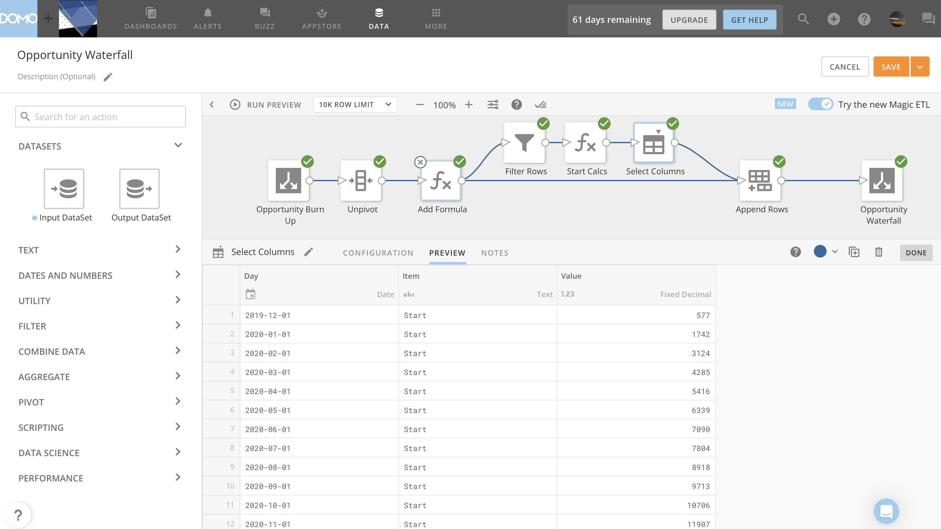

Slide 16
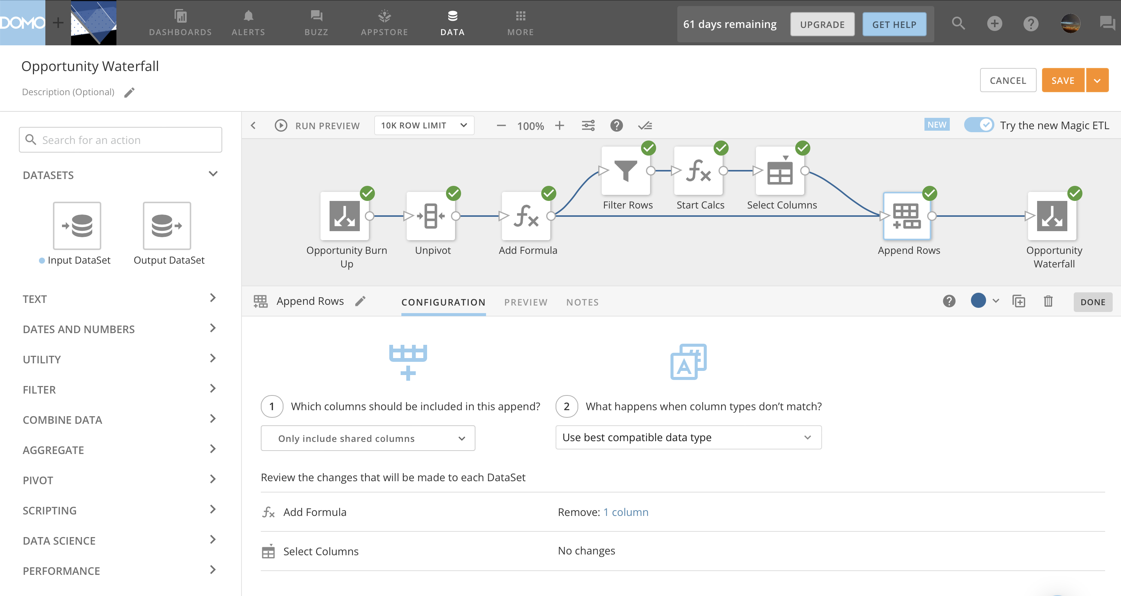

Slide 17
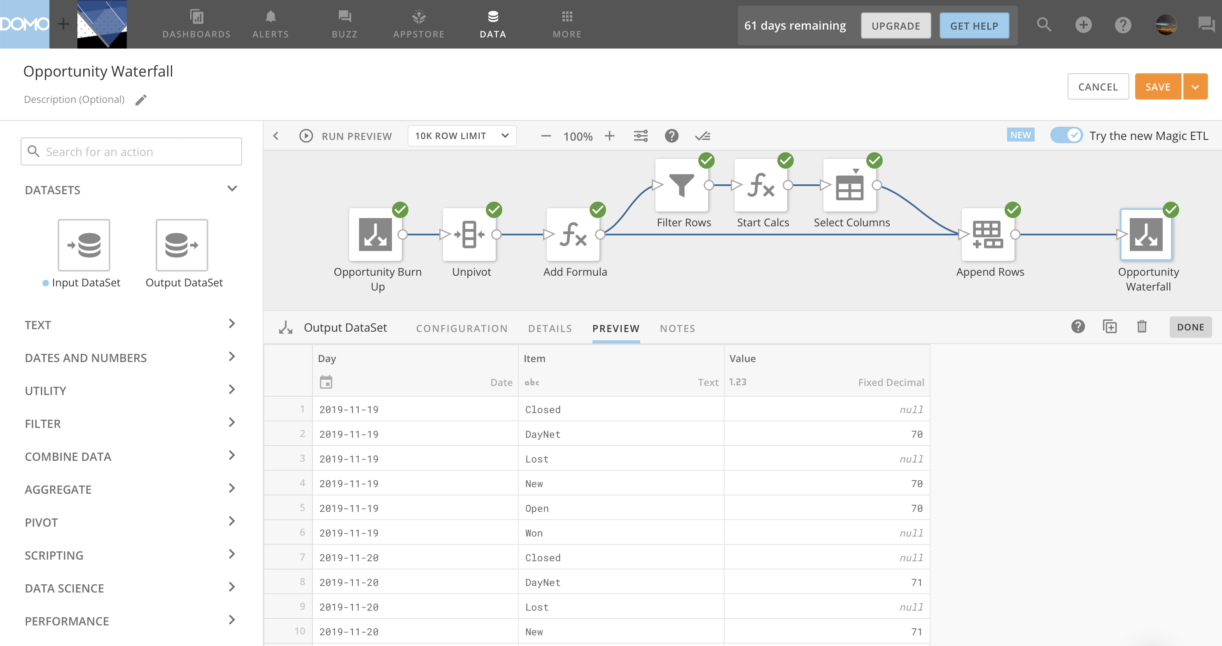

Slide 18
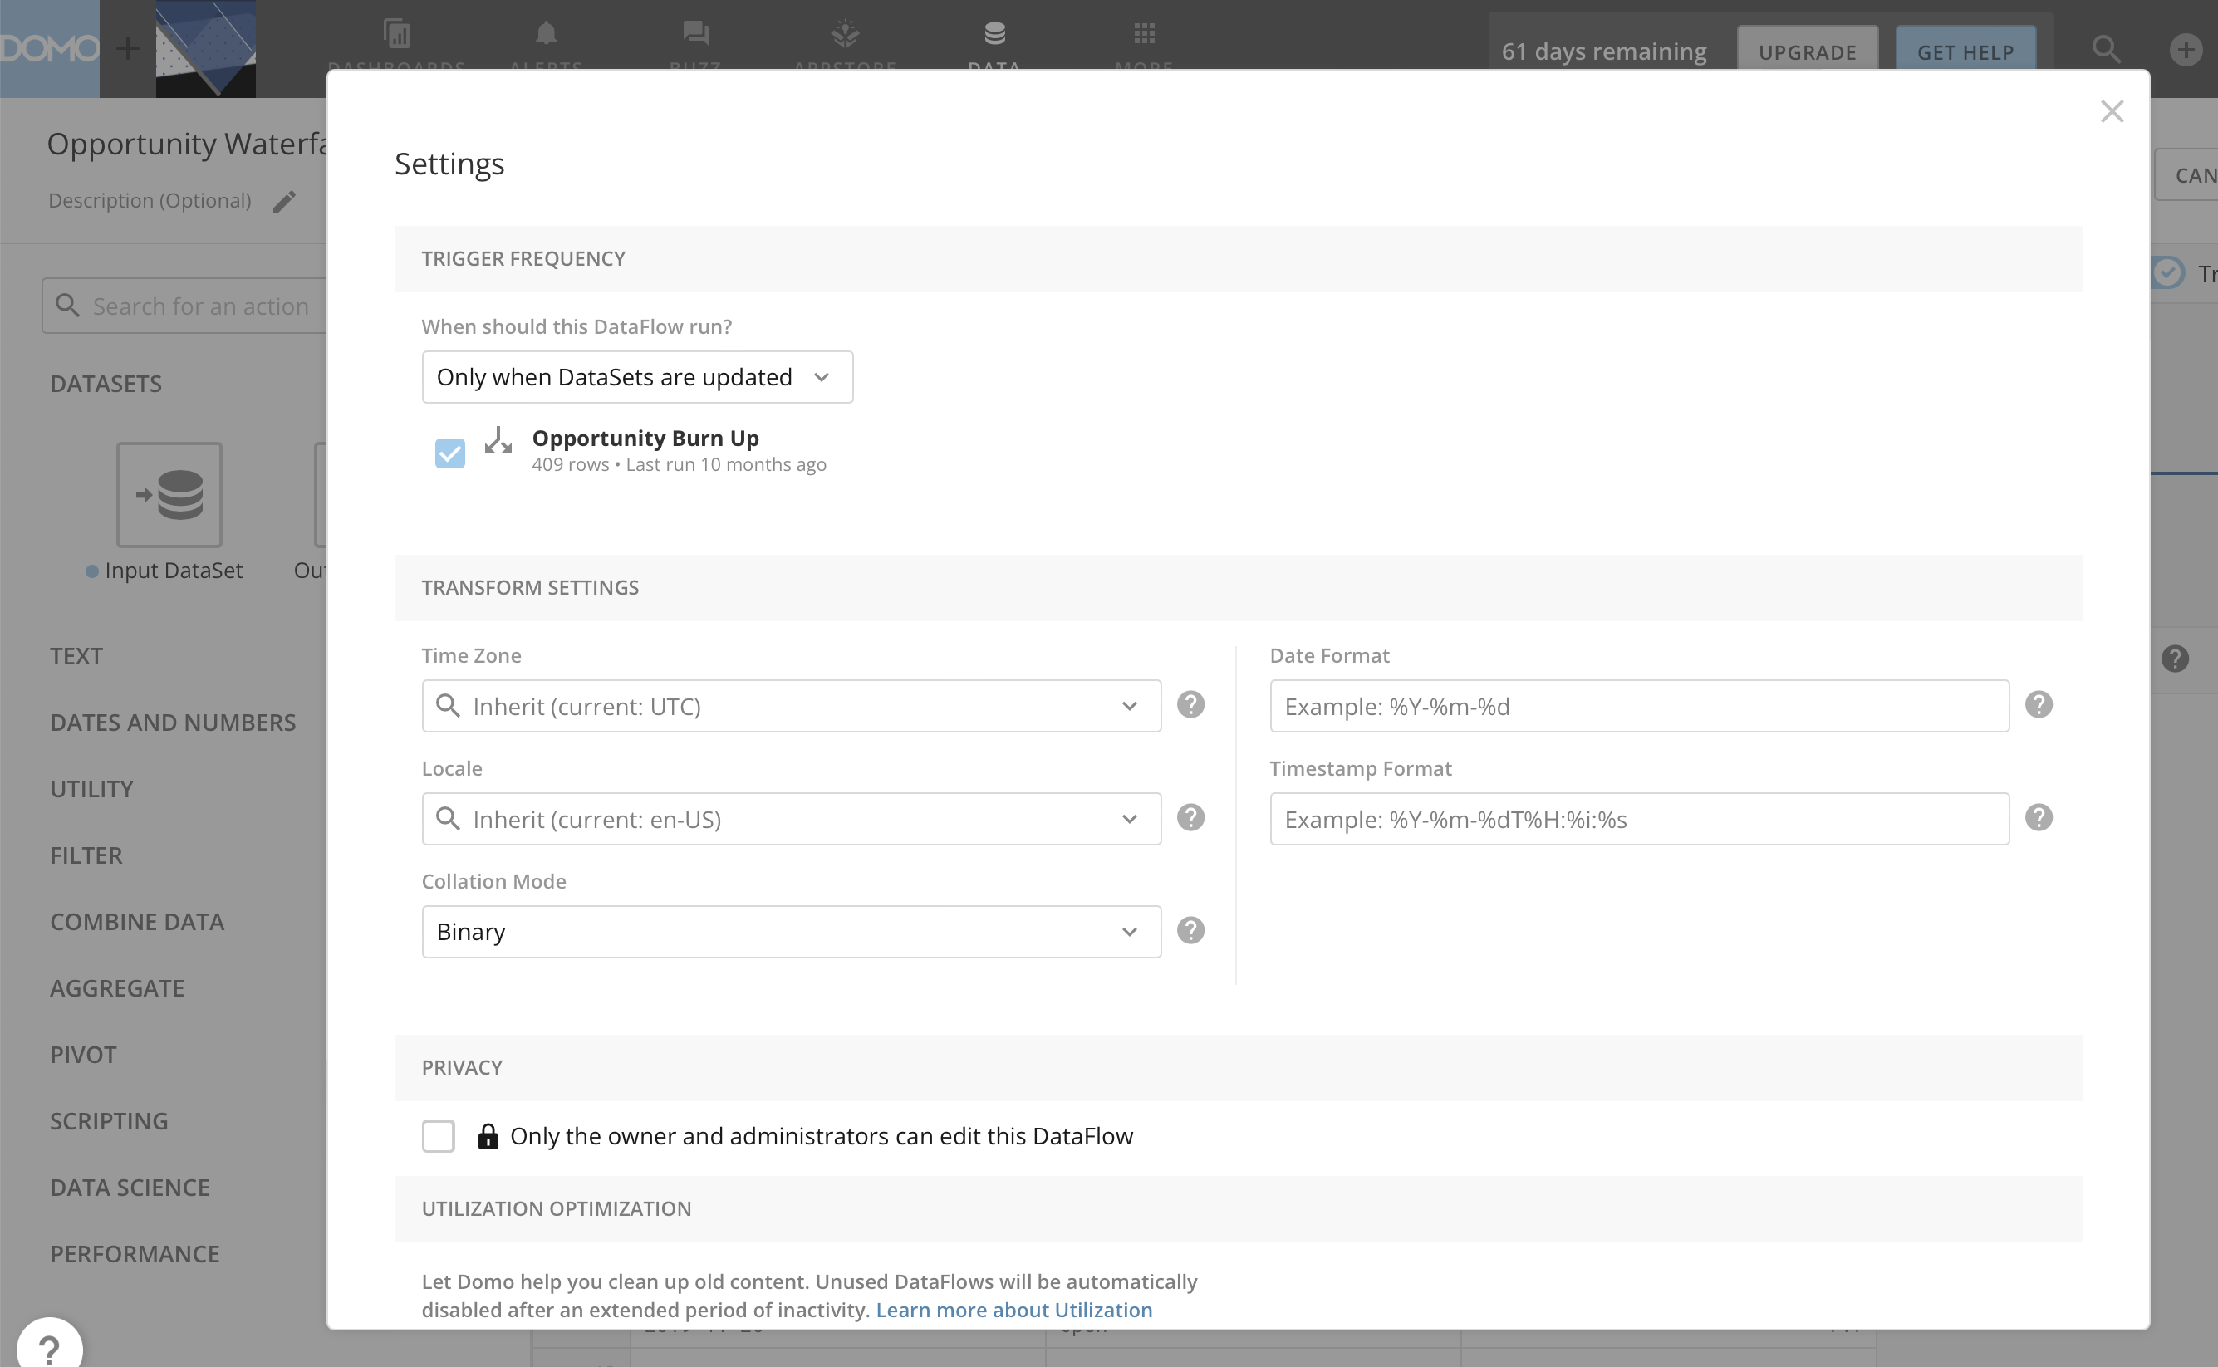

Slide 19
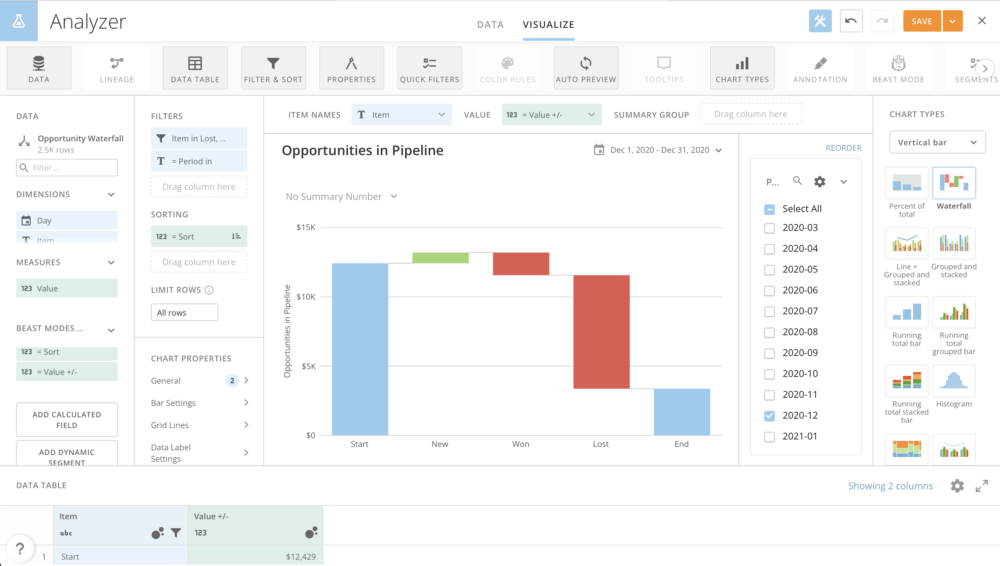

Slide 20
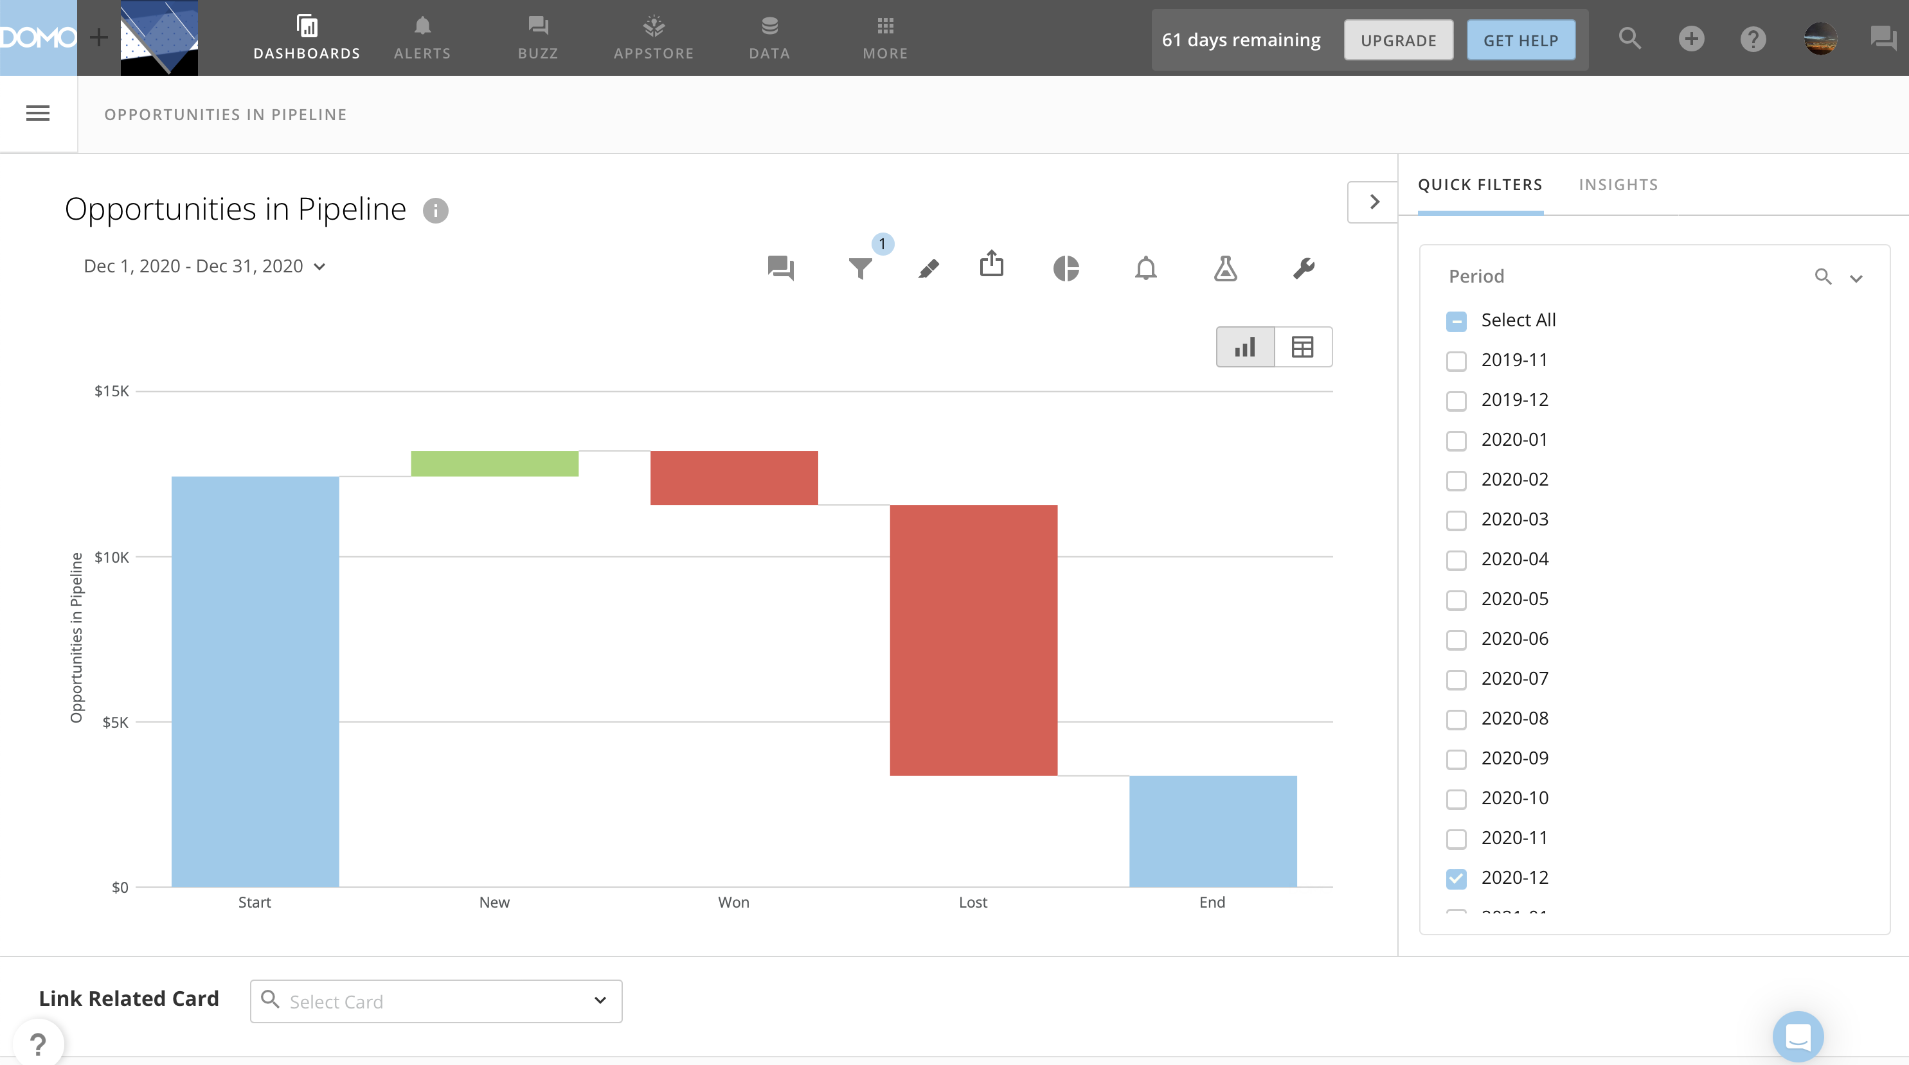
Where Am I Now?
How Did I Get Here?
Why?
Where will I Be?
What Changed?

